Slide 1
Big Data isn’t always Better Data
Workshop W2 at 2018 BioIT World
By
Ray Liu, PhD
Michael Kane, PhD
Lauren Cain, PhD
Tuesday, May 15| 8:00-11:30 am

Slide 2
http://euler.stat.yale.edu/~mjk56/bioit-2018.pptx

Slide 3
Is data a commodity?

Slide 4
Commodity: a basic good used in commerce that is interchangeable with other commodities of the same type. Commodities are most often used as inputs in the production of other goods and services. -- Investopedia

Slide 5
Does data have intrinsic value?

Slide 6
Predictive/Associative Information
+
Action
=
Value

Slide 7
Predictive/Associative Information ->
Data + Analysis

Slide 8
Why don’t they scale in p?
is an underdetermined system

Slide 9
Why don’t our analyses scale in n?

Slide 10
What about unsupervised learning?

Slide 11
What about unsupervised learning?
The curse of dimensionality.

Slide 12
The first rule of Big Data Analysis: You don’t analyze big data.
- For big p (high-dimensional data) this means finding relevant subspaces (column space).
- For big n this means finding relevant subpopulations (row space).

Slide 13
The first rule of Big Data Analysis: You don’t analyze big data.
More generally, you need to find a low-dimensional, information rich representation.

Slide 14
High-dimensional data
Supervised
Unsupervised

Slide 15
A supervised example: The local interactome

Slide 16
The problems with having a lot of samples (n >> p)
You have the population… of something.
You may have a lot of different contexts

Slide 17
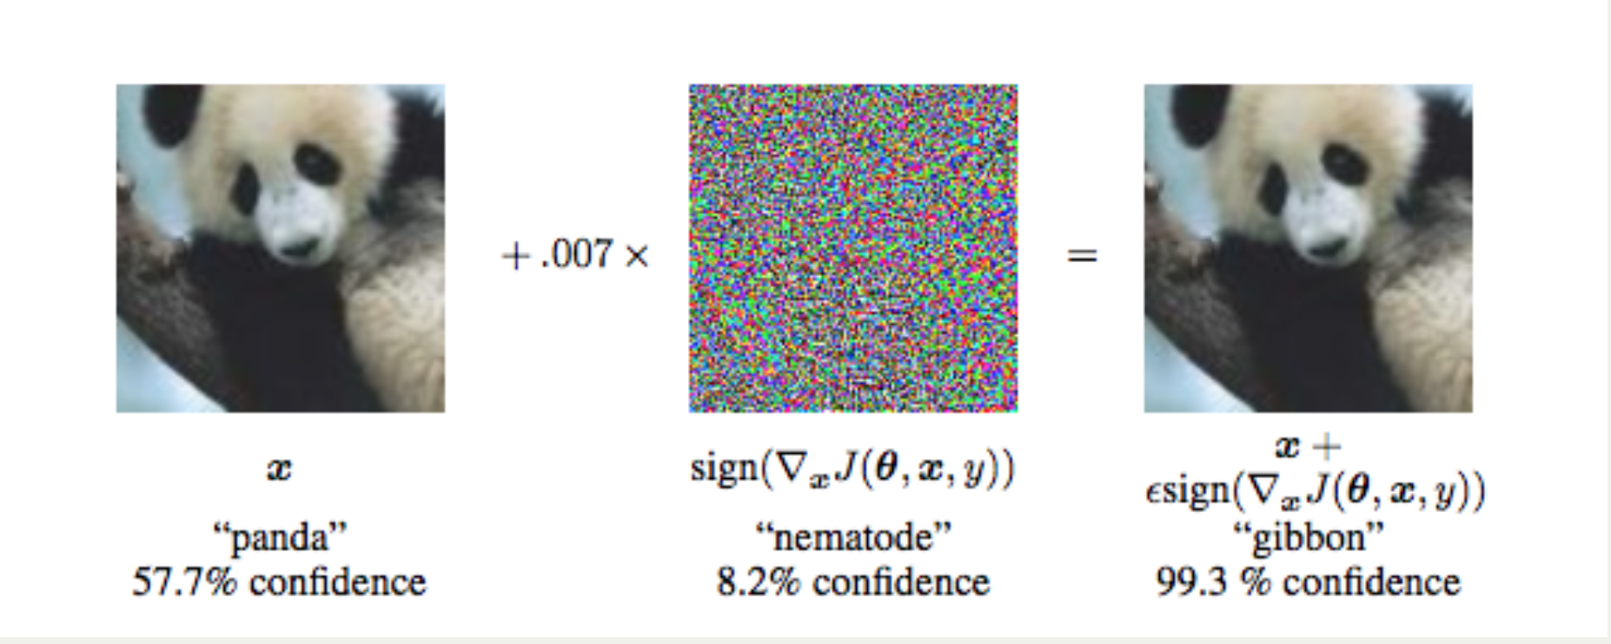
The problem with non-linear learners

Slide 18
Suppose we want to predict flight arrival delays for BOS Dec 2008
2098 flights to predict
- 7009729 total flight
- 117944 total flights into BOS that year

Slide 19
What do you really want to do with the model?
A record linkage analogue

Slide 20
We have historical data that includes using
Departure time
Day of week
Origin
Departure delay
(69 variables after factor expansion).

Slide 21
Airline On-Time Results
SD of response is 45.3
 | Residual Out-Of-Sample SD | Sample Size
Full Model | 41.4 | 112069
Similarity Model | 39.7 | 2080 (2%)

Slide 22
What about when p and n are large?
Almost always sparse
When they are not, they usually are up to a linear transformation

Slide 23
The 1000 genome example

